Slide 2
In the RUP, the actual tang of users is conducted() at the-------- phase of development Select one
a. Elaboration
b. Design
C. requirements
d. Transition

Slide 3
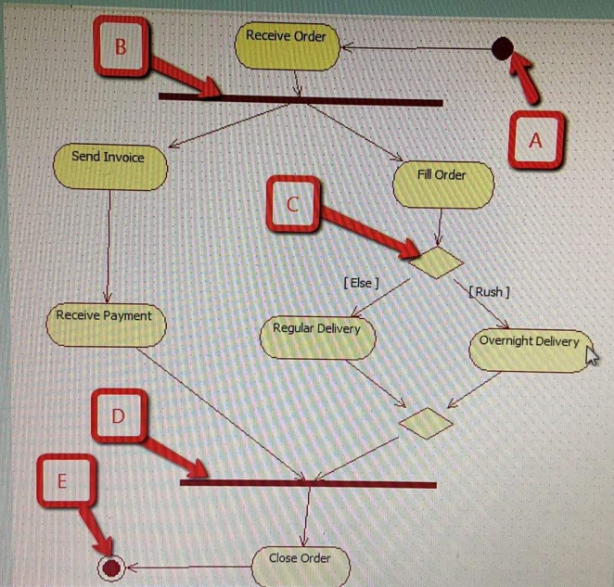
A-Start B-Jon C-decision node, D-Fork, E-End
True
False
The activity Close Order is performed after combining all parallel activities
True
False
The activity Regular delivery is done before performing Receive Payment activity
True
False
The activities Fall Order and Send Invoice can be done in parallel
True
False
The activities Overnight Delivery and Regular Delivery can be done in parallel
True
False

Slide 4
the most common actor in a use case is a human who is identified by
a. first and last name
b. the department name
c. the organization's name
d. the name of his/her role

Slide 5
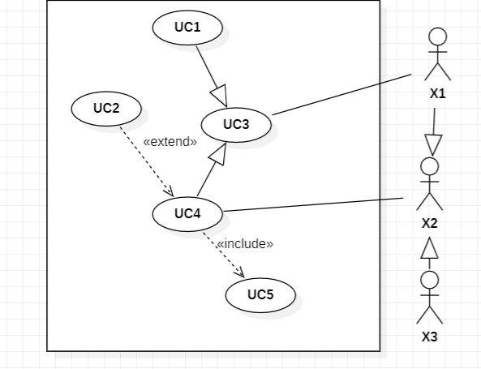
X3 can interact with the system using UC4
x2 is a real actor
XI can interact with the system using UCI and UC4
UC5 is a compulsory(إجباري) port of UC4
UC1 is unused
UC3 is an abstract use case with no steps of its own
Uc4 is an optional(اختياري) part of UC5
UC2 is on optional(اختياري) part of UC4
UC4 is a compulsory(اجباري) part of UC2

Slide 6
“Issue hospital card” could be the responsibility of which of the following roles
A. registration clerk
B. nurse
C. doctor
D. medical staff

Slide 7
The statement “To verify insurance plan, there is a need for valid health insurance plan” is a--------------.
A. precondition
B. trigger
C. postcondition
D. any of these

Slide 8
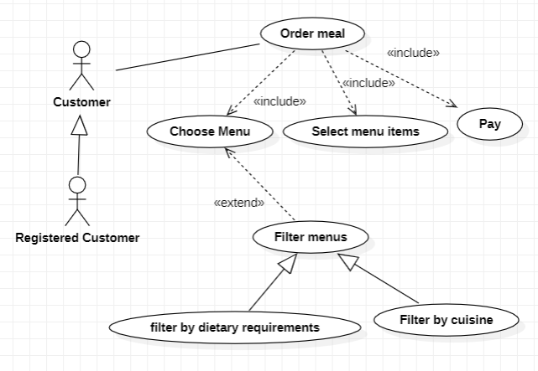
Which of the above actors is an abstract actor
customer
None
registered customer

Slide 9
we can combine actors at the same time through
a. specification
b. generalization
c. both specification & generalization
d. nether specification or generalization

Slide 10
A vehicle has several parts such as the set of wheels and the engine. Busses and cars are examples of some vehicles found on the roads. Consider the following classes:
(i) Engine and Vehicle
(ii) Vehicle and Car
(iii)Vehicle and Road
The correct relationships between the above classes are
a. (i) association (ii) inheritance (iii) association
b. (i) aggregation (ii) inheritance (iii) association
C. (i) aggregation (ii) association (iii) inheritance
d. (i) inheritance (ii) aggregation (iii) association
e. (i) aggregation (ii) inheritance (iii) aggregation

Slide 11
The <<extend>> relationship between use cases would be used when behavior in the extending use case is ----------- the extended use case.
A. always needed by
B. unrelated to
C. sometimes needed by
D. never needed by

Slide 12
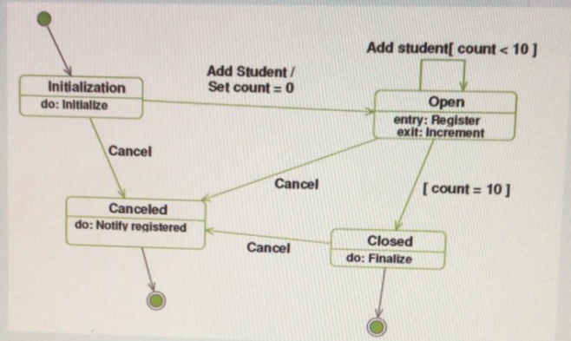
Using the above diagram, fill in the blanks with appropriate words/phrases.
(i) The above UML diagram is called a Activity diagram.
(ii) For which object is the above diagram drawn? Student
(iii) Add Student is an example of an activity in the above diagram
(iv) Action is an example for a behavior that occurs while the object is transitioning into the state.
is an example for such an action

Slide 13
The behavior of an object is described by a-------
a. instance variable
b. attribute
c. instance method
d. class method

Slide 14
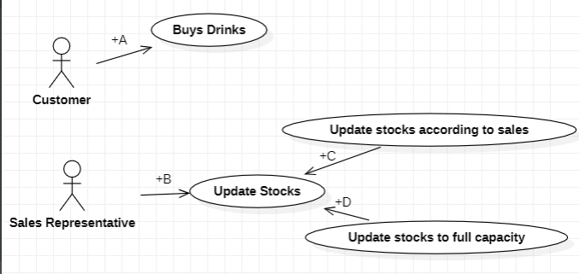
Which of the following gives the correct matching(s) for A-D?
A. A-Association, B-Association, C-Extend, D- Included.
B. A-Communicate, B-Communicate, C-Inheritance, D- Inheritance.
C. A-Association, B-Association, C-Include, D- Included.
D. A-Association, B-Association, C-Extend, D- Extend
E. A-Communicate, B-Communicate, C-Generalization, D- Generalization

Slide 15
Things that are grouped together into containers are called ------------ is
a. collaborations
b. interactions
C. state machines
d. packages
e. classes

Slide 16
The bulk() of implementation is performed during() the ____ phase,
a. investigation
b. design
c. construction
d. transition

Slide 17
In the example "order Dessert(Ice Cream, 2)", Ice Cream is a
a. parameter
b. value
c. argument
d. operation

Slide 18
Which relationship occurs when one use case allows a new use case to handle an exception or variation from the basic use case?
a. Includes
b. Generalizes
C. Extends
d. Communicates

Slide 19
"a Patient is covered by an Insurance Policy" is an example of
a. aggregation
b. generalization
c. inheritance
d. association

Slide 20
-----------defines the state of the system before a use case starts.
a. Pre condition
b. Post condition
c. both Pre condition & Post condition
d. neither Pre condition or Post condition

Slide 21
Aggregation represents the relationship of a----------.
a. whole to a part
b. object to a class
c. whole to a whole
d. part to a part

Slide 22
What is the goal of the construction phase of the UP?
a. to fully design the system
b. to understand the requirements of the system
c. to complete the system
d. to release a product

Slide 23
Which use case label indicates that one use case provides a variation of the behaviors and actions to the use case it is connected to?
a. <<extend>>
b. <<expand>>
c. <<add>>
d. <<include>>

Slide 24
When do we use extended use case?
extends relationship a use case is optionally extended by functionality of another use case
Optional behavior

Slide 25
What do we mean by the state of an object?
object is an entity that is affected by the flow. It may be used or changed by an activity in the flow.

Slide 26
The model of the sequence of actions of an actor and the corresponding responses of the system is known as a(n)------------.
a. use case scenario
b. event table
c. expanded use case narrative
d. flow of events

Slide 27
A use case represents
a. the role a user plays when interacting with the system.
b. the system's functionality under various conditions.
c. a class its attributes and operations.
d. a business case for using an information system.

Slide 28
A use case is a model of a(n)
a. computer process
b. event
C. computation
d. requirement

Slide 29
The statement "the patient is registered and is provided with a hospital ID Card" is considered as---------- for "register patient" use case.
a. precondition
b. trigger
c. postcondition
d. all of these

Slide 30
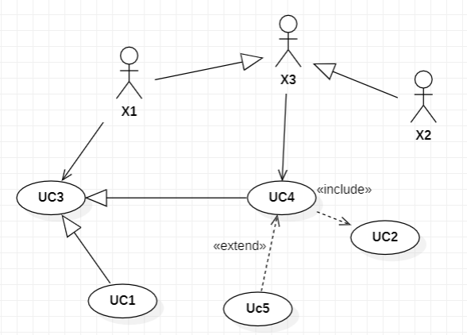
Is an options part of UC4
A. UC2 b. UC5 c. UC2 AND UC5 d. UC2, UC5 AND UC3
Which of the above use cases can be used by X2
A. UC4 b. UC4, UC5 AND UC3 c. UC4, UC5 AND UC2 d. UC4, UC5, UC2 AND UC3
Which of the above actors is an abstract actor?
A. X2 b. X1 c. X3 d. X2 and X1
Which actor interact with the system using UC4
A. X1 b. X2 c. X1 AND X2 d. X1, X2 AND X3
Is an abstract use case with no steps of its own
A. UC1 b. UC4 c. UC5 d. UC2 e. UC3
X1 can interaction with the system through
A. UC3 b. UC4, UC1 c. UC3, UC4 AND UC1 d. UC1, UC2, UC3, UC4 AND UC5

Slide 31
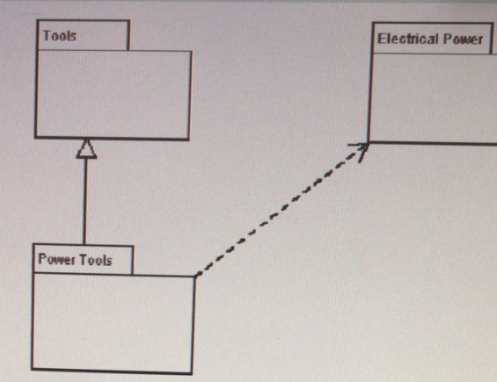
Which of the following statements is correct regarding the above diagram?
The relationship between Electrical Power and Power Tools is a generalization
Power tools is a classes
The package Power Tools depends on the package Electrical Power
The package Electrical Power depends on the package Power Tools

Slide 32
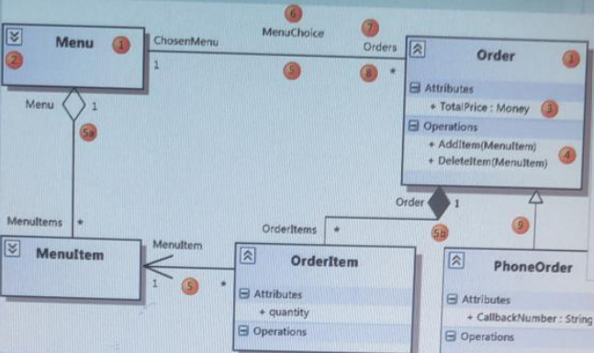
1 represent Class
3 represent Attribute
4 represent Operation
5 represent Association
5a represent Aggregation
5b represent Composition
6 represent Association Name
7 represent Role Name
8 represent Multiplicity
9 represent Generalization

Slide 33
?
The advantages of distributed object architecture are:
Dynamically reconfigurations
Openness
Scalability
All of them

Slide 34
?
One sub-system has overall responsibility for control and starts and stops other sub-systems
Event-based control
Layered-based control
Module-based control
Centralized control

Slide 35
